Slide 1

MGM’S POLYTECHNIC, AURANGABAD. Mechanical Department
Capstone project Title
3D PRINTER FILAMENT MAKER
by
Veersing Pardeshi 32112
Mohammed saad 32115
Arvind gaikwad 32108
Raees ather ali 32219
Under the Guidance Of
Prof. Shingare R.P.

Slide 2


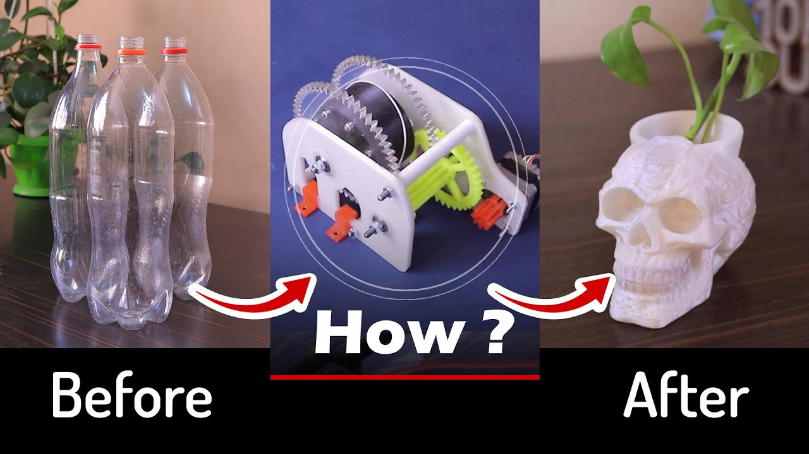
3d printer filament maker
Guide : Prof.Shingare sir

Slide 3
Abstract
The purpose of this project is to recycle the plastic bottle waste material into a useful filament by using an Filament maker machine. The study focuses on forming a new filament by using recycled Polyethylene Terephthalate (PET) from plastic waste. The recycled filament is then utilized to an open-source 3D printing to create a specimen. The investigation of its mechanical properties is done by comparing the tensile strength, tensile strain, maximum load, and modulus young to pure PET material data. The result shows the original PET specimen can withstand a 724N maximum load while recycled PET specimen can accept 713N.

Slide 4
CONTENT
INTRODUCTION
HISTORY
DIFFERENCE
COST ESTIMATE
ACTUAL EXERCISES
ASSEMBELY
PROBLEM FACED
SOLVED
TRAIL AND ERROR
TESTING

Slide 5
What is filament maker
It is use to recycle the waste plastic bottle
It can convert the plastic bottle into 3d printer filament
It can reduce the cost of the production of model
It gives finishing like other filament

Slide 6
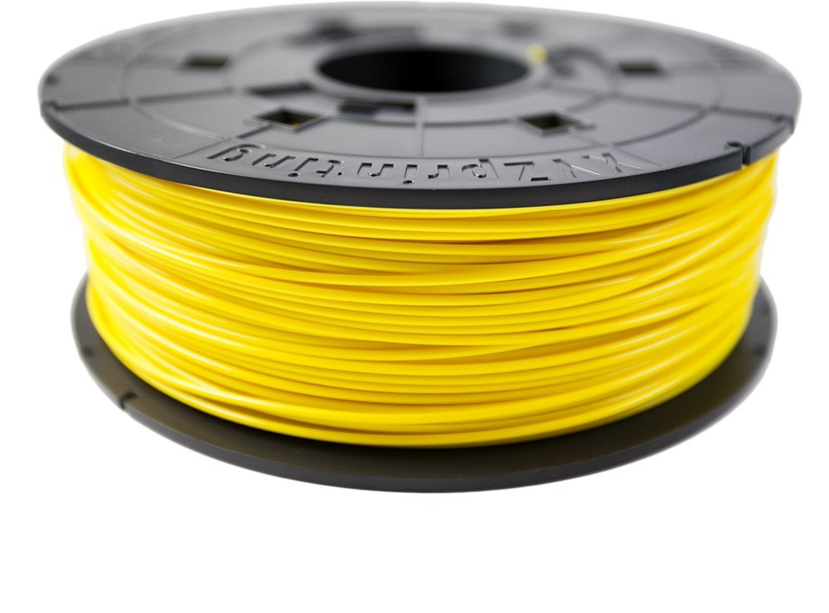
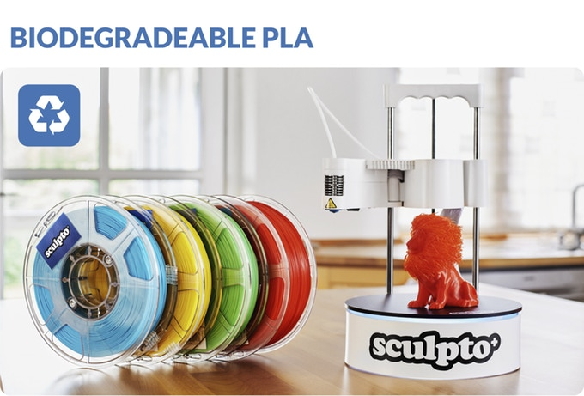
HISTORY
IN 3D PRINTER THE USE OF FILAMENT IS ABS, PLA , PETG ETC
THEY ARE MORE COSTLY
IN 3D PRINTING THE MATERIAL LOSS HAPPENED BECAUSE OF SUPPORT AND ERROR
THE WASTAGE OF FILAMENT HAPPENED
FOR SMALL MODEL USE OF HIGH QUALITY FILAMENT
This Photo by Unknown author is licensed under CC BY-SA.
This Photo by Unknown author is licensed under CC BY.

Slide 7
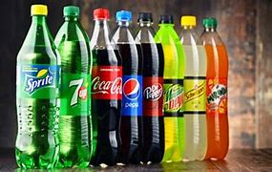
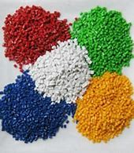
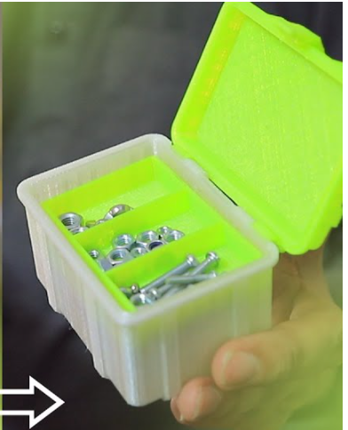
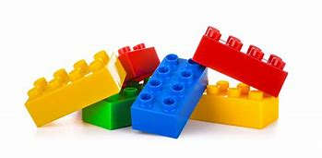
DIFFERENCE BETWEEN PET AND PLA , ABS ,
PET ()
MADE FROM WASTE PLASTIC BOTTLE
MORE USEFULL FOR SMALL AND NON USED PRODUCT
ECONOMICAL 15 RS / KG
ABS ()
MADE FROM three monomers called Acrylonitrile, Butadiene, Styrene.
FOR SMALLAND NON USE MODEL COST IS SO HEIGH
MORE COSTLY 1000 RS / KG

Slide 8
PRODUCTION COST ESTIMATE OF PET AND ABS
MATERIAL COST : 15 rs/ kg
ELECTRICITY BILL : 100 rs for 24 hr
ERROR COST : 10%
REUSE COST : 0%
STRENGTH : MODRATE
AVALABILITY : ANYWHERE
MATERIAL COST : 1000 rs/ kg
ELECTRICITY BILL : 100 rs for 24 hr
ERROR COST : 25%
REUSE COST : 80%
STRENGTH : HIGH
AVALABILITY : ONLINE ORDER ONLY

Slide 9
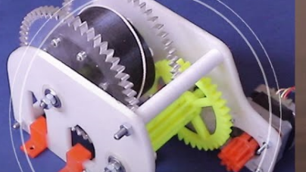
GEAR TRACTION KIT MAKING PROCESS

Slide 10
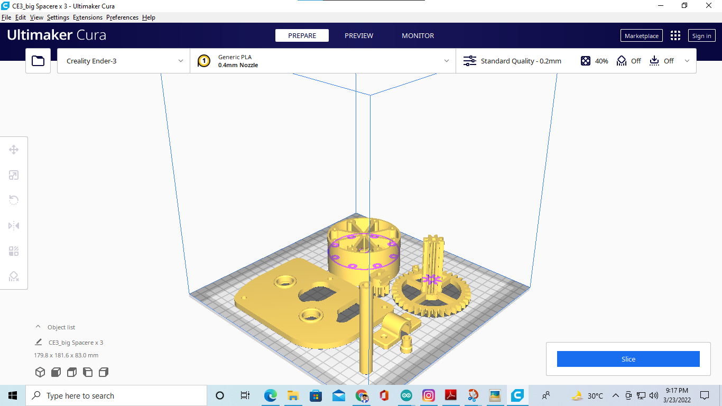
3D MODEL OF ALL PARTS

Slide 11
1.Costing of products
SR NO. | PRODUCT NAME | QUANTATY | PRICE
1 | Arduino Mega+RAMPS 1.4 Shield+4 x A49AA Stepper Driver | 1 | 1500
2 | Nema 17 Stepper motor | 4 | 3000
3 | 3D PRINTED PARTS | 1 | 1200
4 | E3D Hotend | 1 | 450
5 | 240watt Power Supply- | 1 | 1000
6 | LCD Display(optional | 1 | 200
7 | MK8 Extruder | 1 | 250

Slide 12
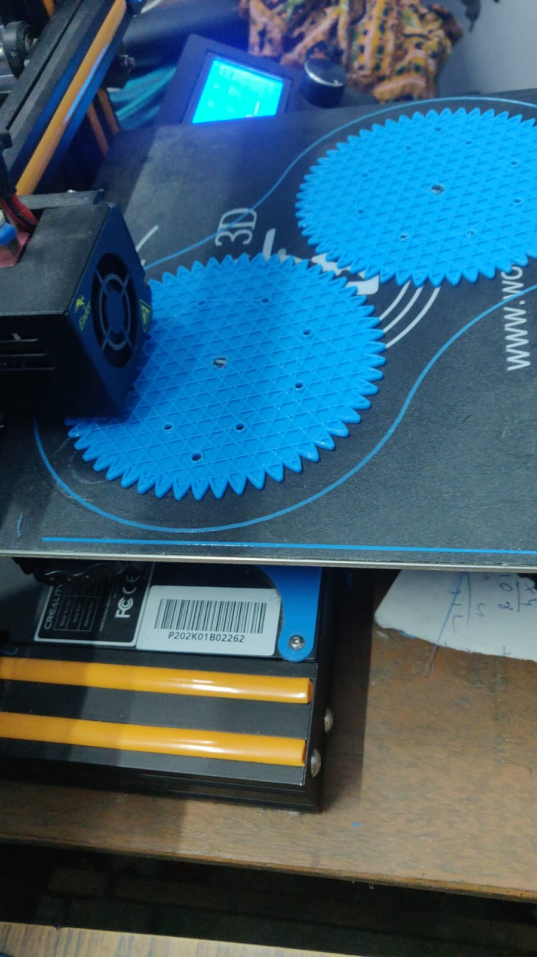
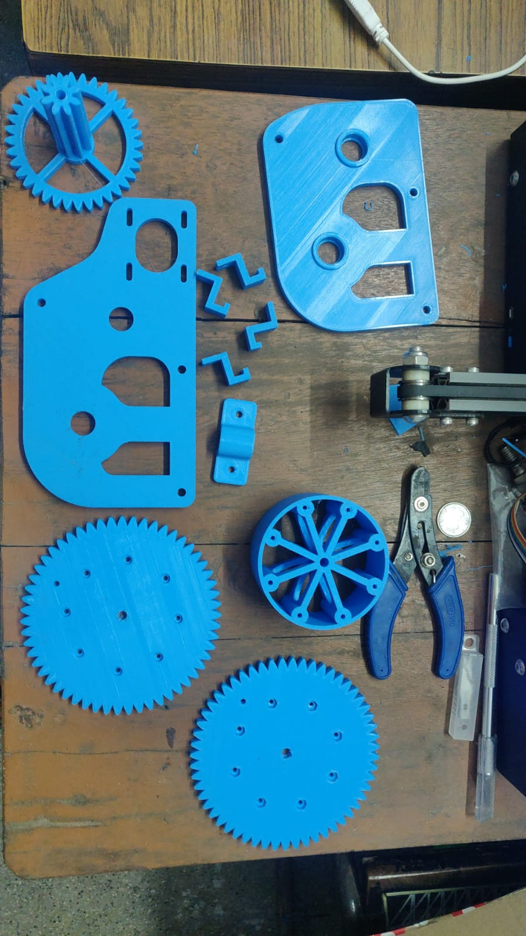
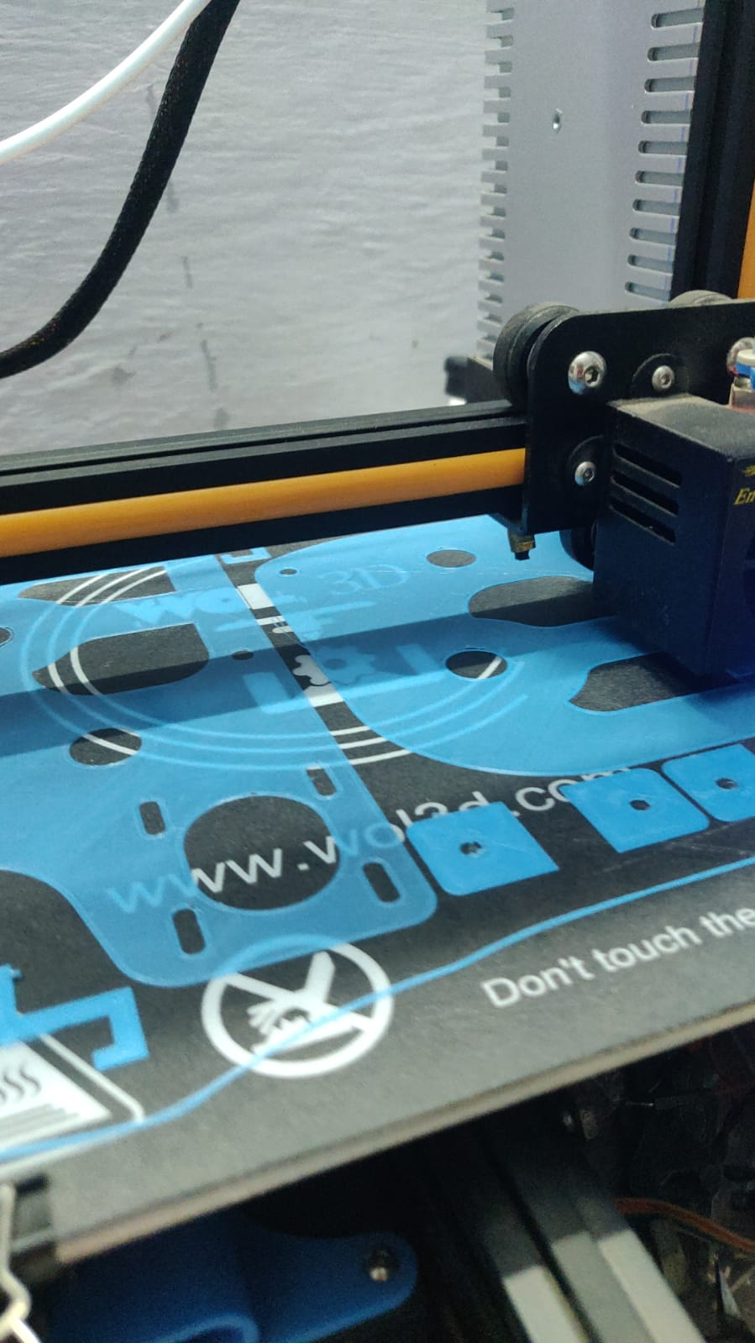
PRODUCTION FROM chennai

Slide 13
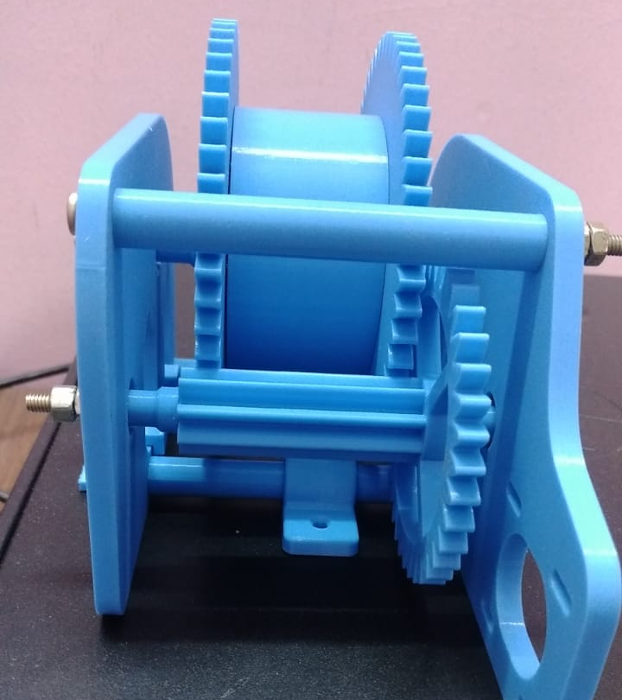
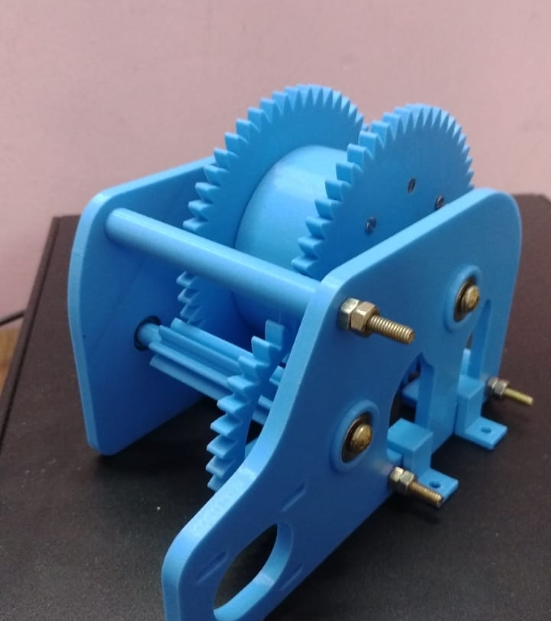
ASSEMBELY OF GEAR TRACTION

Slide 14
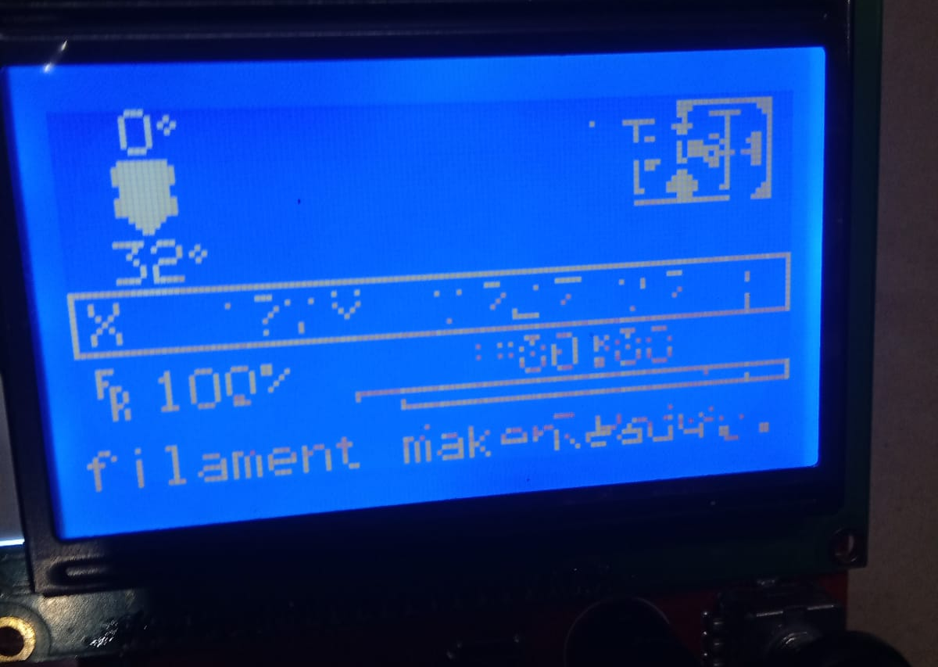
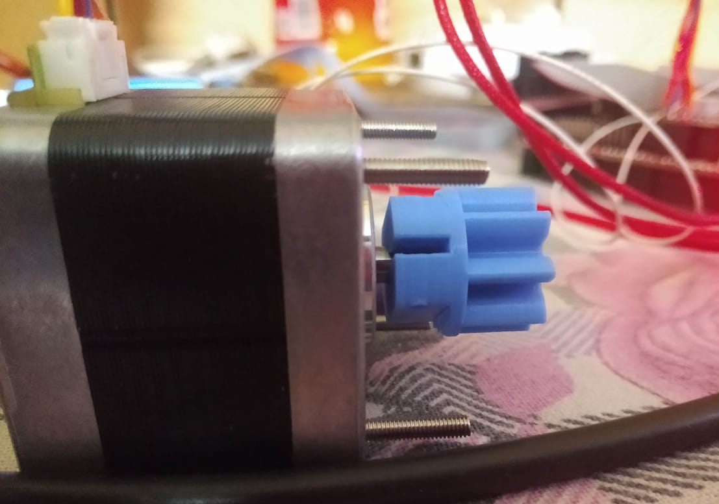
Problem that we faced
Some electronic part are not working properly due to some coading error .
And correct power supply to display .
And steper moter not working properly.
High cost of 3D print component
Approx 10 to 15K

Slide 15
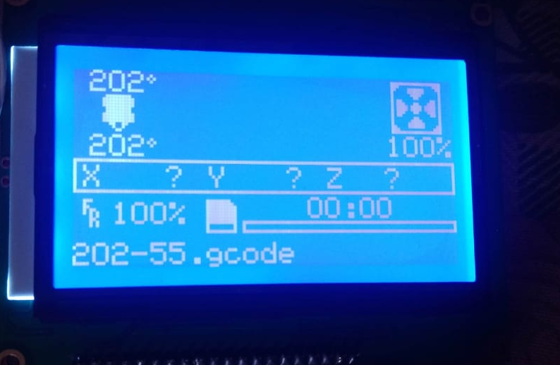
Solved :
We correct the coding error by the guidance of facility guide
And the problem of high cost 3d printnted component we order from all that part from banglore at 1200 rs

Slide 16
Testing And Error .
We are going to use some different type of plastic bottle for as material to produce filament .
Error :
some error related to accuracy and finshing we are trying to get more finsh and accuracy

Slide 17
Thank You

